Slide 1
European Soccer Predictions with Fifa Ratings
Can a simple model beat the bookies?

Slide 2
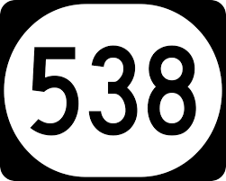

Motivation
By supplementing a model with player ratings from the FIFA video games, can I make predictions better than professional gamblers? How much money would this strategy win (or lose)?

Slide 3
Data
25,979 matches from 2008 to 2016
Keep only matches in the Premier League, Bundesliga, La Liga, Ligue 1, and Serie A
Features include:
Each player who started the game
Weekly ratings for each player
Date, Home/Away, Team Ratings
Also includes gambling lines from 10 different sites

Slide 4
Model
Gambling sites correctly guess the outcome of each match 53% of the time – this constitutes success
Ultimately, a profits a success if we can turn a profit
XGBoost
Most important feature was an exponentially weighted moving average of previous outcomes

Slide 5
Takeaways
Model is not too far away – Test accuracy is 50%
And we turned a profit!
Are the differences between leagues significant?
Would a neural network perform better? Improvement in feature engineering?
FIFA Team ratings very significant – Offensive ratings seem to matter more

Slide 6
Thank you!
Michael Scheriger
michael.scheriger@gmail.com

